Slide 1
Content Management System Security
By –Prakash Khasor, Assistant Professor(Cyber Security), Institute of Forensic Science, Gujarat Forensic Sciences University

Slide 2
Introduction
What is CMS?
Why CMS Security is Important ?
CMS Security and Penetration Testing

Slide 3
What is CMS?
CMS is Stand for Content Management System
A Content Management System is a System that facilitates creating, editing, organizing and publishing content.
CMS is mostly used for Web Publishing.
Content Management Application
Content Delivery Application

Slide 4
Types of CMS Platforms
Opensource
Wordpress
Joomla
Drupal
Magento (e-commerce)
PrestaShop (e-commerce)
Proprietary
Kentico
Microsoft SharePoint
IBM Enterprise Content Management
Pulse CMS
Sitecore
Shopify

Slide 5
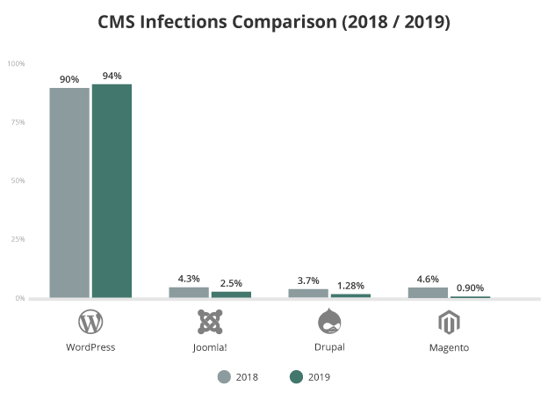
Why CMS Security is Important?
Some Advantages of CMS:
Its easy for non-technically minded
It allows multiple users.
It streamlines scheduling
It improves site maintenance.
Design Changes are simple.

Slide 6
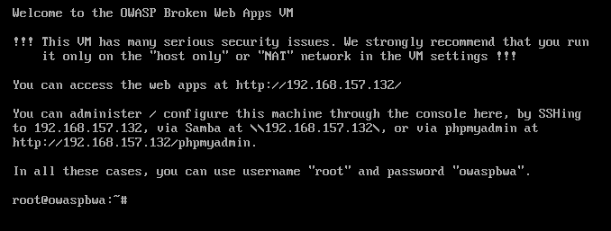
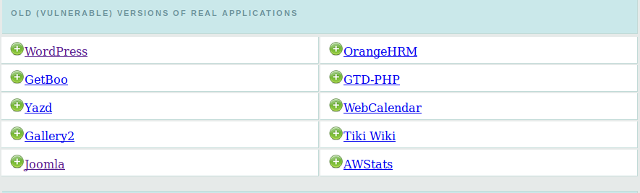
OWASP Project for CMS Security
OWASP Broken Web Applications
It have Vulnerable CMS for Security Practices

Slide 7
Owasp top 10
Code Injection Vulnerability
An injection can occur when a website gives its users the option to enter data
Broken Authentication
It can allow a hacker to either capture the credentials during authentication or to bypass the authentication altogether. This becomes a ‘broken authentication’ vulnerability.
Sensitive data exposure
Sensitive data exposure takes place when software doesn’t have adequate measures in place to protect data while in transfer or storage
XML External Entities (XXE)
This kind of vulnerability allows attackers to interfere with an application’s processing of XML data.
Broken Access Control
Upon successful verification to the attacker It grants the user access to content and functions

Slide 8
Continue..
Security Misconfigurations
Improper security configurations refer to weakness in the coding or omissions of security protocols that end up giving hackers an easy pass
Cross-Site Scripting (XSS)
Cross-site scripting is a type of injection attack. It exploits user inputs and browser cookies to run malicious JavaScript code on users’ browsers.
Insecure Deserialization
The vulnerability occurs when deserialization accepts untrusted user input.
Using Components With Known Vulnerabilities
There are times when websites use outdated software or other components that have known vulnerabilities.
Insufficient Logging and Monitoring
Lack of continues logging and monitoring of application

Slide 9
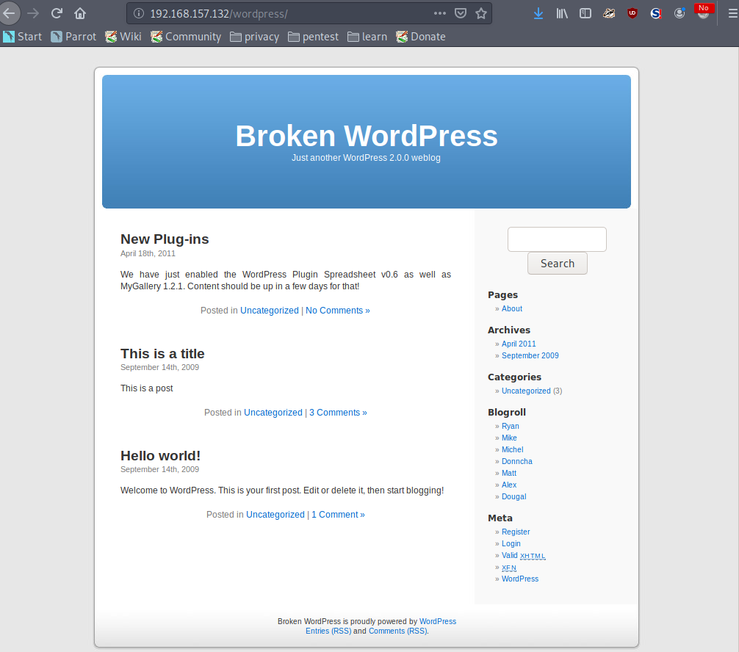
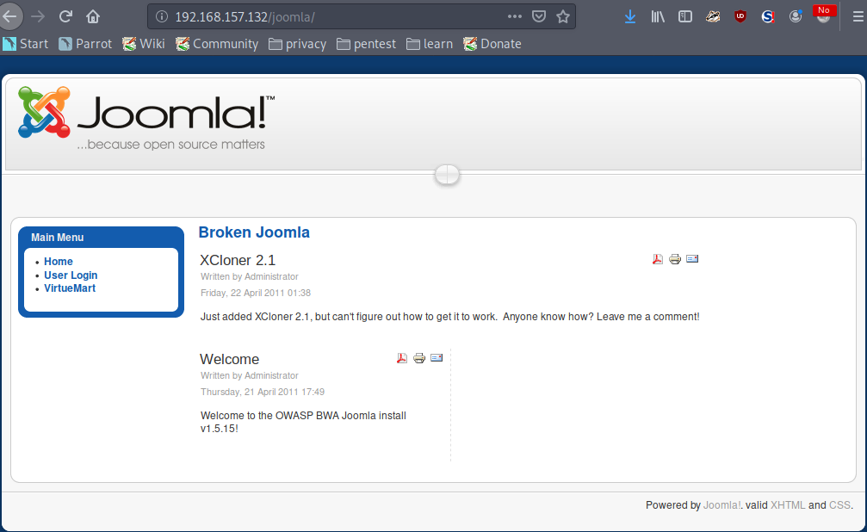
Vulnerable CMS for Pen Testing

Slide 10
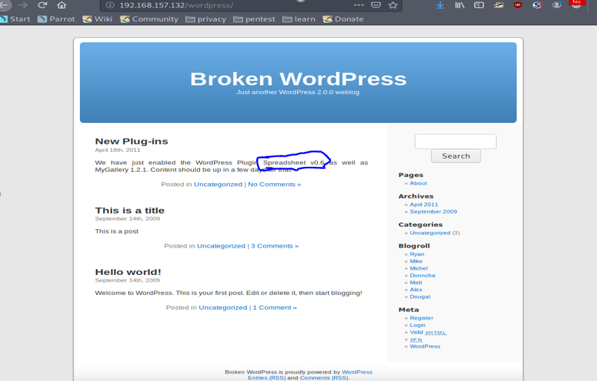
Automated SQL Injection (Broken Wordpress)
Step:1

Slide 11
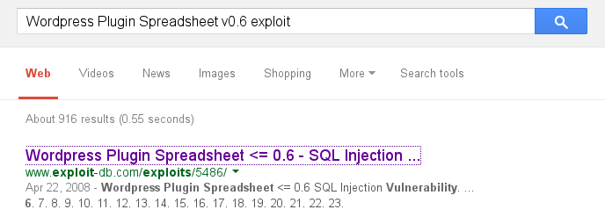
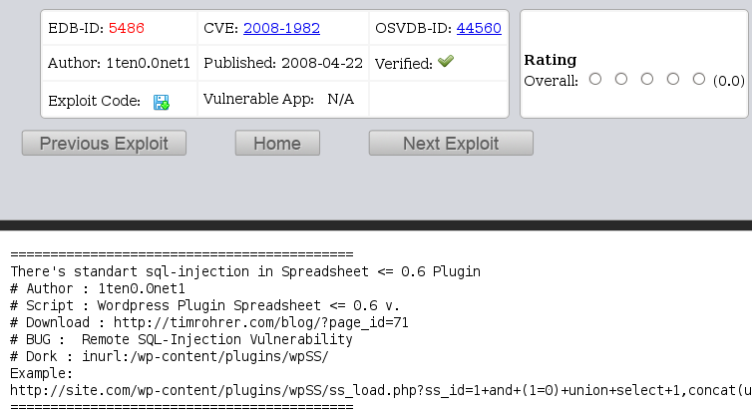
Continue...
Step:2

Slide 12
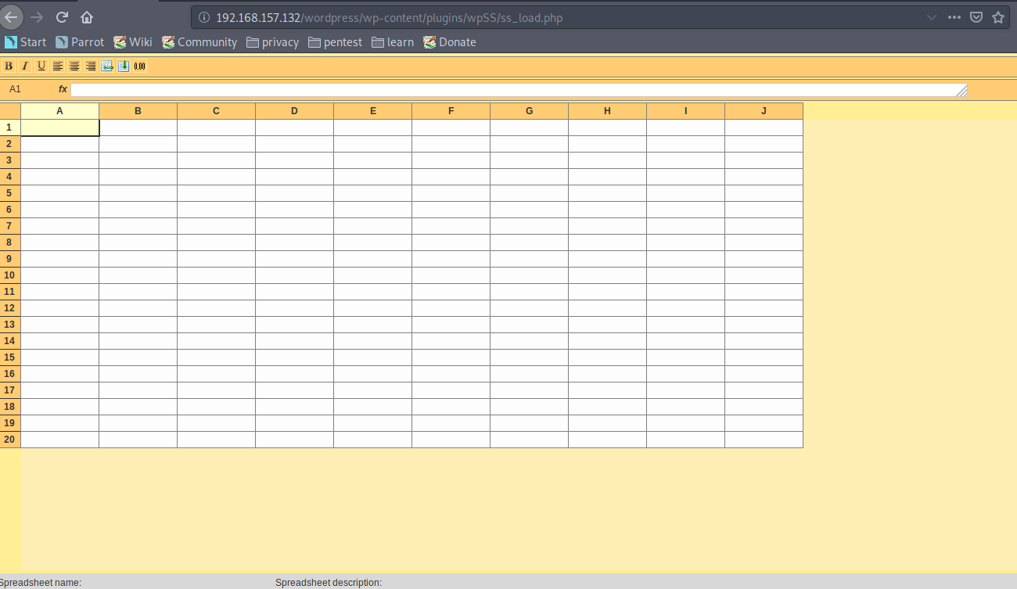
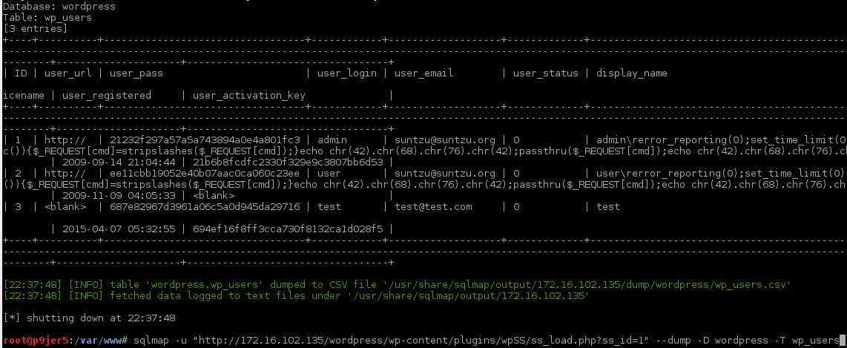
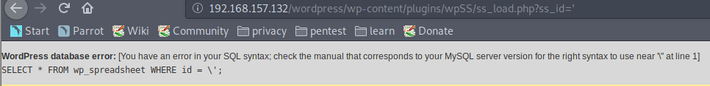
Continue..
Step:3
Step:4

Slide 13
Mitigation SQL Injection
Validation for server-side input
Use SQL controls such as LIMIT
Data sanitization
Use a safe API

Slide 14
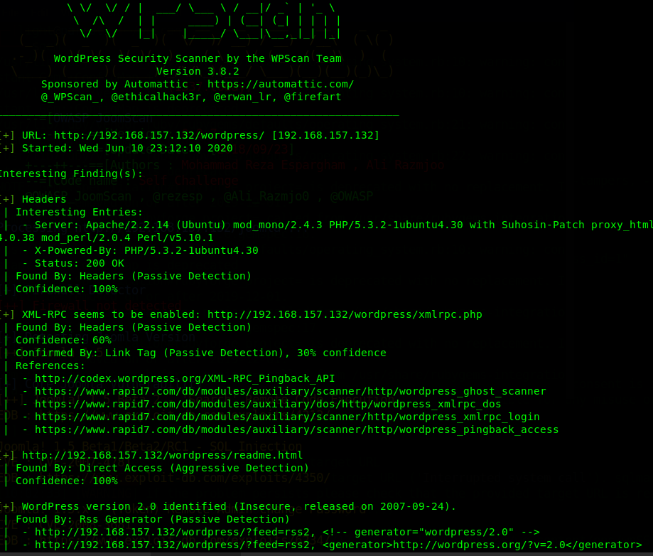
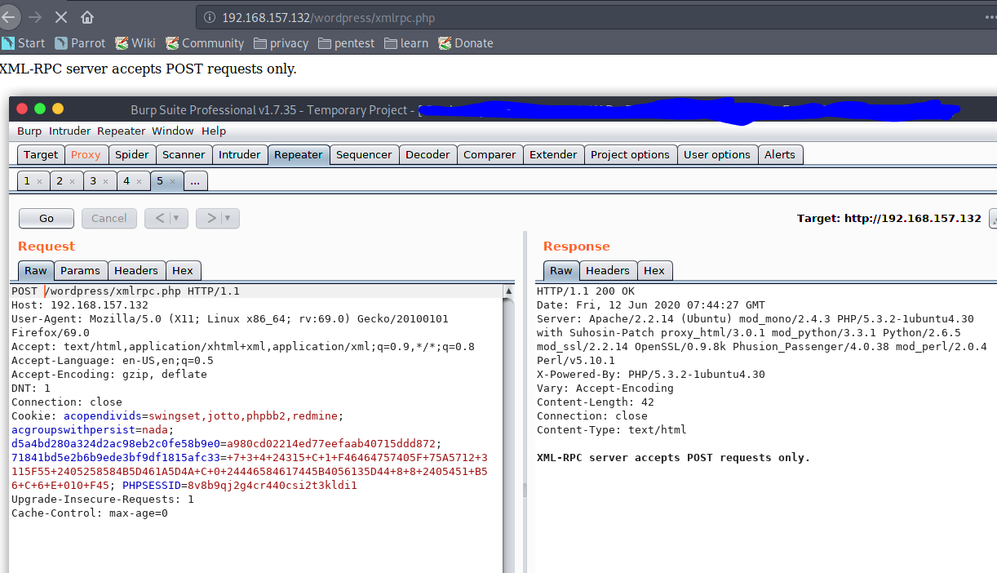
Vulnerable Xml-rpc pingback
Step:1
Step:2

Slide 15
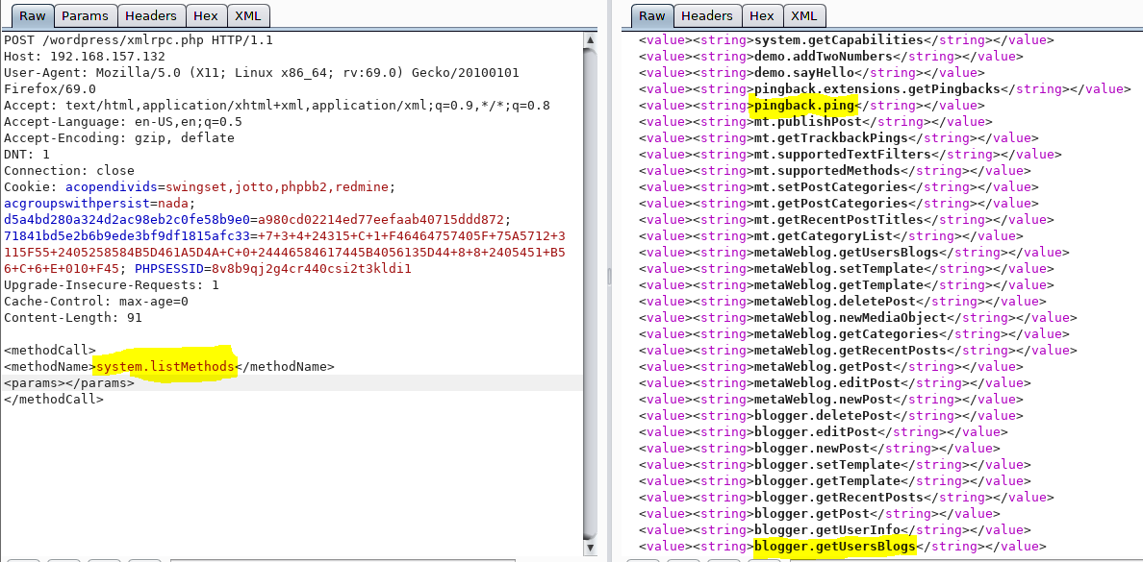
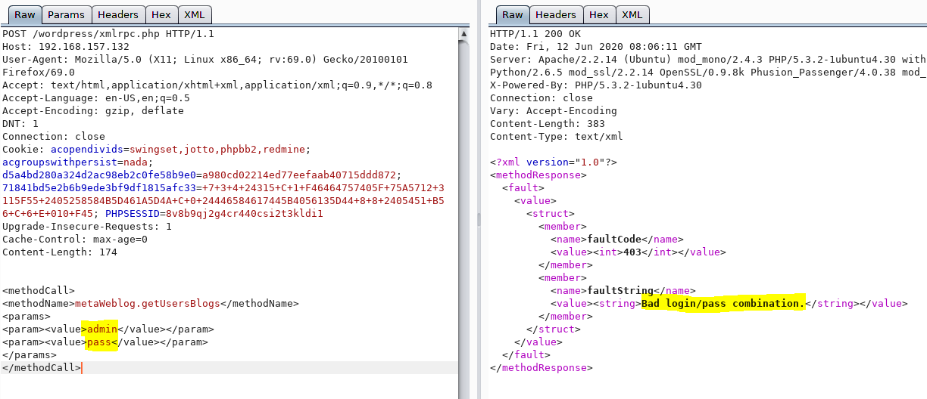
Continue..
Step:3
Step:4

Slide 16
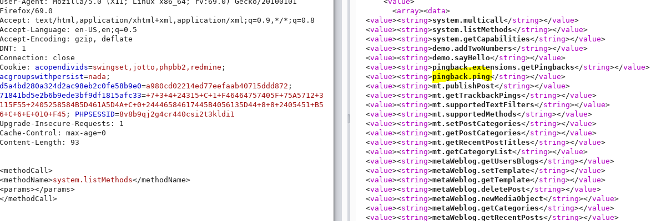
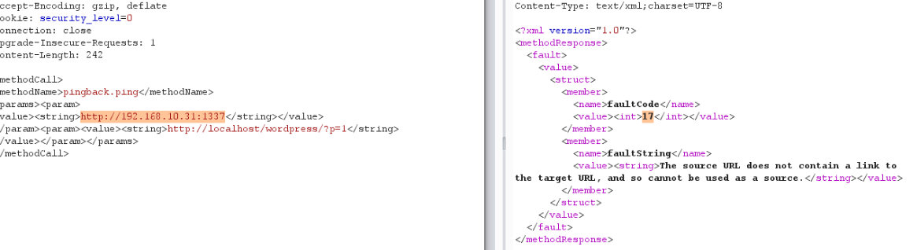
XSPA(Cross site port attack)
STEP:1
STEP:2

Slide 17
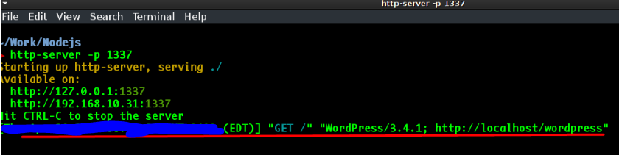
Continue..
Step:3

Slide 18
Mitigations for secure xml-rpc
Reconfigure “.htacess”
Disable XML-RPC + Pingback WordPress Plugin
Replace angle bracket text with its symbol Angle brackets files xmlrpc.php.
Whitelist

Slide 19
Reference
https://www.bloomreach.com/en/blog/2019/08/content-management-system.html
https://w3techs.com/technologies/overview/content_management
https://webflow.com/blog/website-security-checklist
https://medium.com/@the.bilal.rizwan/wordpress-xmlrpc-php-common-vulnerabilites-how-to-exploit-them-d8d3c8600b32
https://blogvault.net/owasp-top-10/

Slide 20
